Slide 1
Variational auto-encoder on speech commands
Members:
Davide Checchia - 2078232
Jelin Raphael Akkara - 2072064
Kiamehr Javid - 2084294
GROUP-18

Slide 2
OUTLINE
Why do we expect them to work?
Data and preprocessing
Training, architecture
Results

Slide 3
i. Theory recap
Variational Bayes
Variational Auto-Encoder

Slide 4
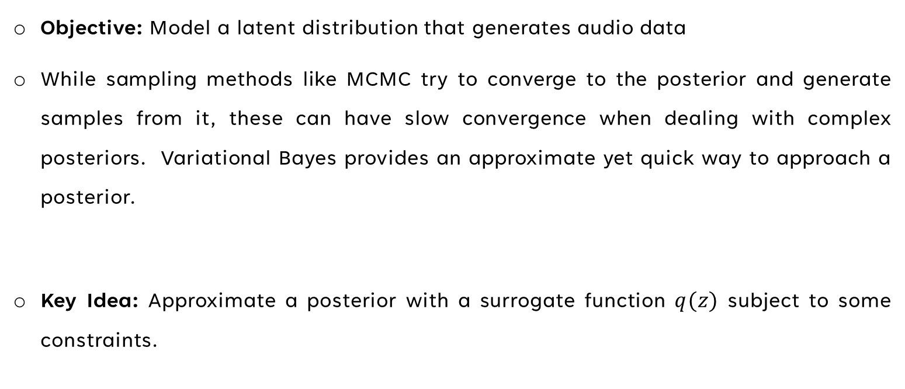
Variational bayes
Objective: Model a latent distribution that generates audio data
While sampling methods like MCMC try to converge to the posterior and generate samples from it, these can have slow convergence when dealing with complex posteriors. Variational Bayes provides an approximate yet quick way to approach a posterior.
Key Idea: Approximate a posterior with a surrogate function $q(z)$ subject to some constraints.

Slide 5
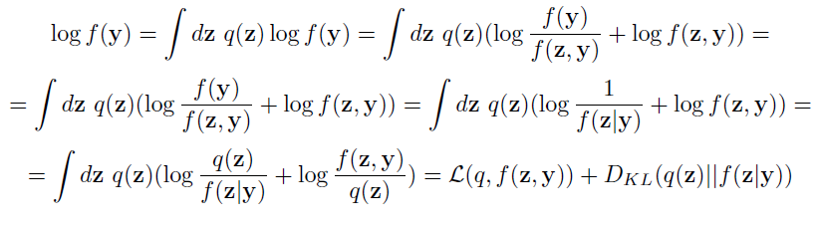
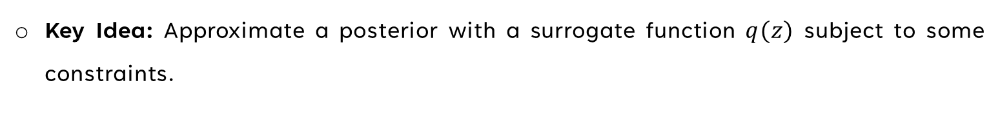
Variational bayes
Key Idea: Approximate a posterior with a surrogate function $q(z)$ subject to some constraints.

Slide 6
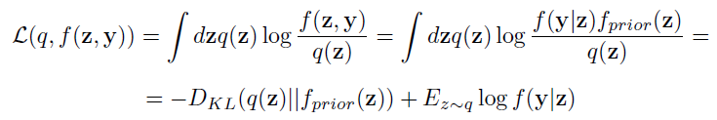
Variational Auto-encoder
Constraining to parameterized family of functions:
Encoder
Decoder

Slide 7
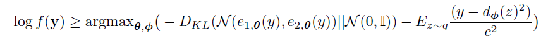
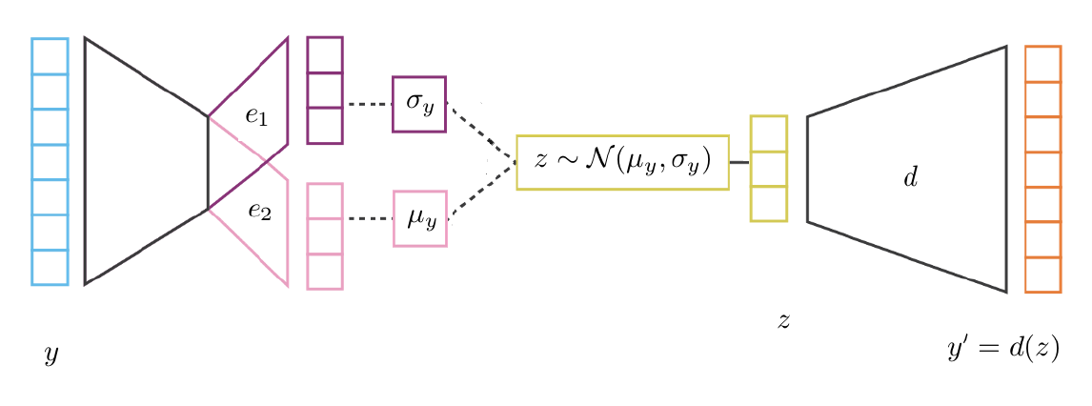
Variational Auto-encoder

Slide 8
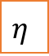
Variational Auto-encoder
$$η$$

Slide 9
Dataset
How does it sound like
Pre-processing

Slide 10
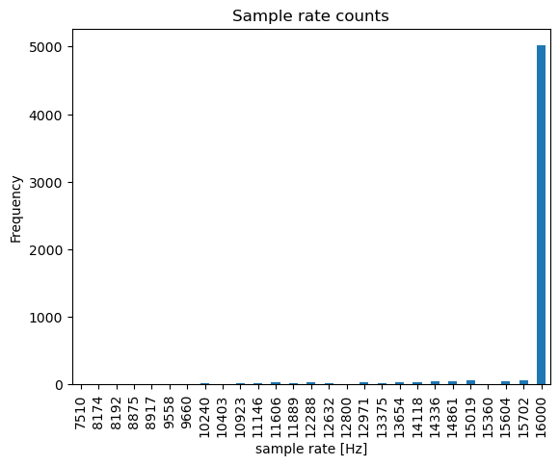
How does the data sound/look
Labeled audio data consisting of 8 speech commands as follows
yes, no, right, left, down, up, stop, go
Wav file format, 16000 samples of the waveform amplitude over a 1 second interval
1000 data points per label. 8000 in total.

Slide 11

THE DATASET
Bad data
Shorter lengths(~13000 samples instead of 22050)
Inaudible or noisy speech
Truncated audio
Non normalized audio
Noisy down
Clear stop
Incomplete yes

Slide 12
pre-processing
What we tried:
Normalizing the waveforms
Center/right padding with or without noise
Training on the waveform
Discrete fourier transform
Short term fourier transform(STFT)
Mel spectrogram
MFCC
What we did not try:
Denoising and smoothening the audio
Filtering the bad data out

Slide 13
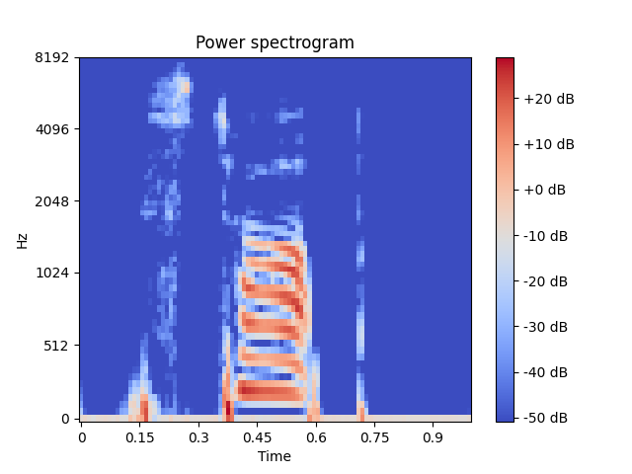
Mel spectrogram
2 dimensional representation of an audio
Shows the share of each frequency bin at each time window
Frequency bins are spaced logarithmically
Phase information is lost and only the amplitude is considered
Not injective hence not perfectly invertible
We can choose the resolution of the frequency bins and temporal window plus the overlap of the windows

Slide 14
Why mel? How much do we lose?
It works
Raw waveform and the FFT leave too much learning to the neural network
STFT keeps the phases but this doubles the size of our input shape
Mel scale is expected to be aligned with human perception of audio. In other words, mel spectrogram is mainly what we have labeled as a speech command
Mel_inv_stop
Clear_no
Mel_inv_no

Slide 15
III. Training
Model
Further notes

Slide 16
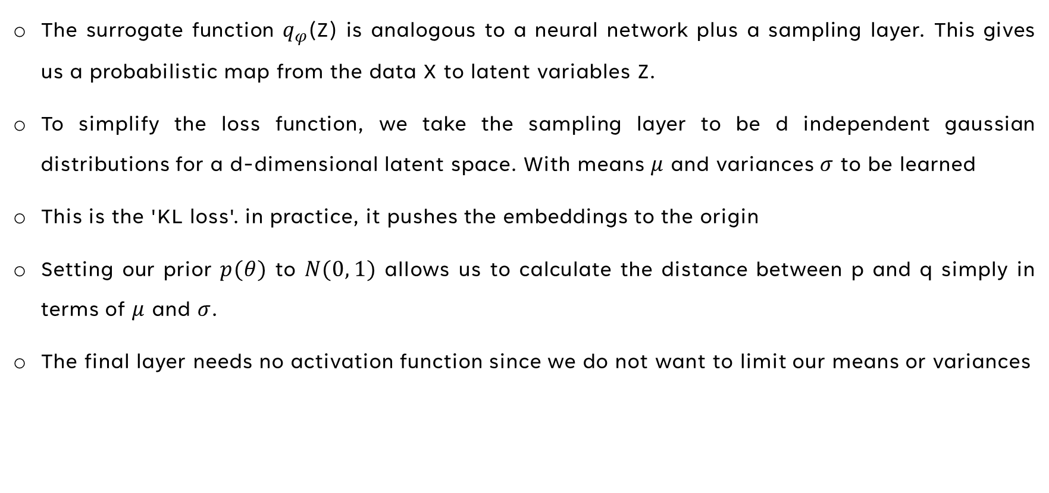
Model: Encoder
The surrogate function $q_{φ}$(Z) is analogous to a neural network plus a sampling layer. This gives us a probabilistic map from the data X to latent variables Z.
To simplify the loss function, we take the sampling layer to be d independent gaussian distributions for a d-dimensional latent space. With means $μ$ and variances $σ$ to be learned
This is the 'KL loss'. in practice, it pushes the embeddings to the origin
Setting our prior $p(θ)$ to $N(0, 1)$ allows us to calculate the distance between p and q simply in terms of $μ$ and $σ$.
The final layer needs no activation function since we do not want to limit our means or variances

Slide 17
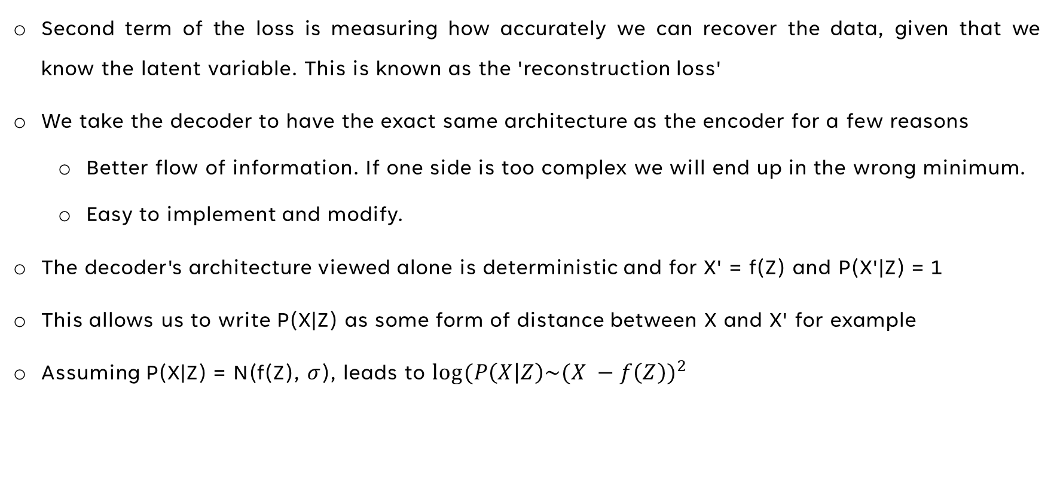
Model: Decoder
Second term of the loss is measuring how accurately we can recover the data, given that we know the latent variable. This is known as the 'reconstruction loss'
We take the decoder to have the exact same architecture as the encoder for a few reasons
Better flow of information. If one side is too complex we will end up in the wrong minimum.
Easy to implement and modify.
The decoder's architecture viewed alone is deterministic and for X' = f(Z) and P(X'|Z) = 1
This allows us to write P(X|Z) as some form of distance between X and X' for example
Assuming P(X|Z) = N(f(Z), $σ$), leads to $log⁡(P\left(X | Z\right)\sim {(X −f\left(Z\right))}^{2}$

Slide 18
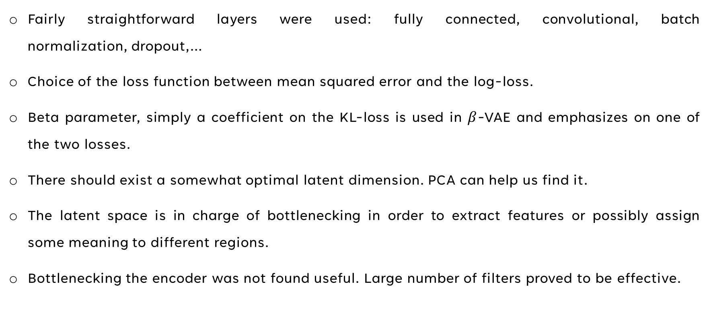
Layers and parameters
Fairly straightforward layers were used: fully connected, convolutional, batch normalization, dropout,…
Choice of the loss function between mean squared error and the log-loss.
Beta parameter, simply a coefficient on the KL-loss is used in $β$-VAE and emphasizes on one of the two losses.
There should exist a somewhat optimal latent dimension. PCA can help us find it.
The latent space is in charge of bottlenecking in order to extract features or possibly assign some meaning to different regions.
Bottlenecking the encoder was not found useful. Large number of filters proved to be effective.

Slide 19
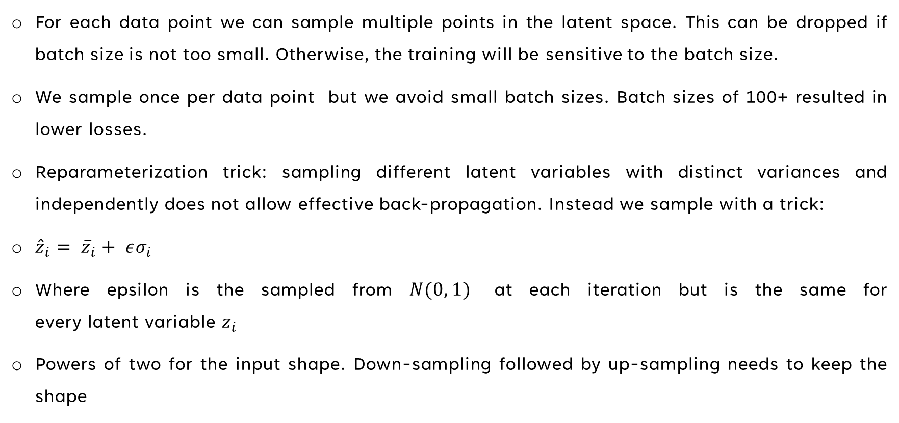
Further notes
For each data point we can sample multiple points in the latent space. This can be dropped if batch size is not too small. Otherwise, the training will be sensitive to the batch size.
We sample once per data point but we avoid small batch sizes. Batch sizes of 100+ resulted in lower losses.
Reparameterization trick: sampling different latent variables with distinct variances and independently does not allow effective back-propagation. Instead we sample with a trick:
${\hat{z}}_{i}= {\overline{z}}_{i}+ εσ_{i}$
Where epsilon is the sampled from $N(0, 1)$ at each iteration but is the same for every latent variable $z_{i}$
Powers of two for the input shape. Down-sampling followed by up-sampling needs to keep the shape

Slide 20
IV. results
Notable models
Clusters

Slide 21
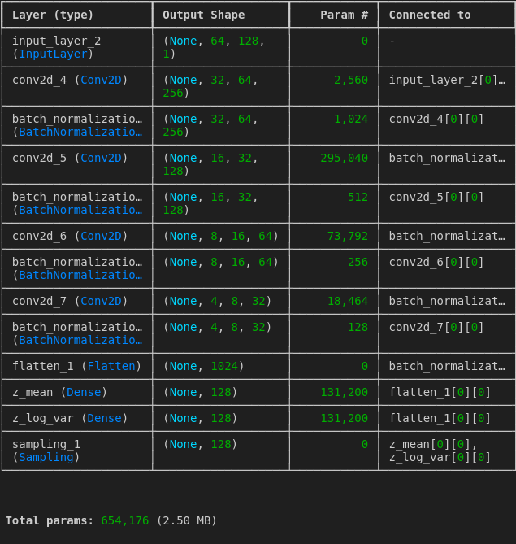
Notable models: the complex one
Original_1
Regenerated_1
Original_2
Regenerated_2
Mean_left
Original_3
Regenerated_3
Latent_noised_3
Beta parameter = 1e-3

Slide 22
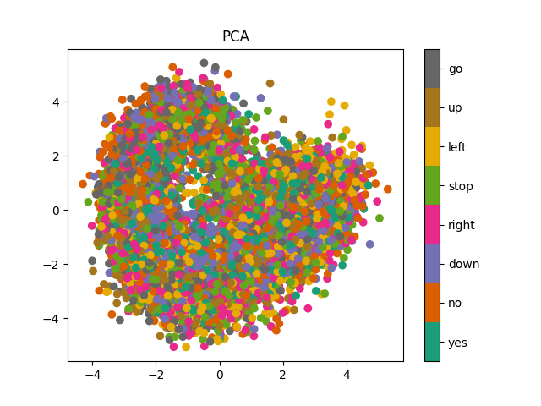
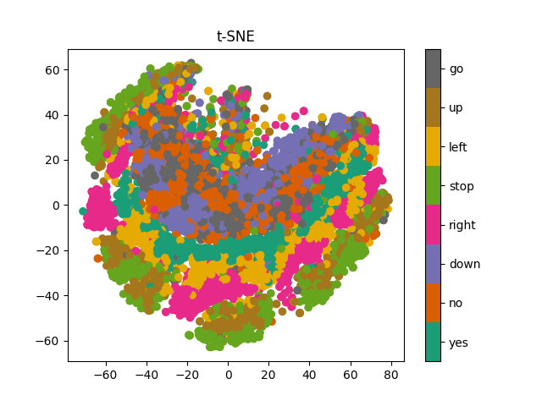
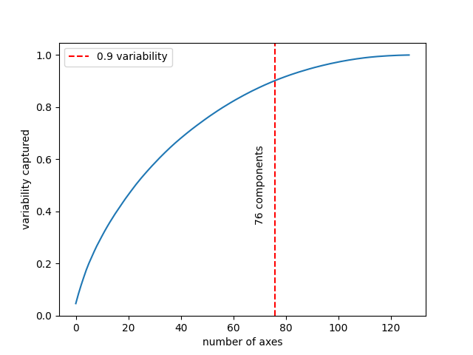
Notable models: the complex one
Clusters exist but mean of each label does not sound like speech. Multiple clusters per label
We can do better and with lower complexity

Slide 23
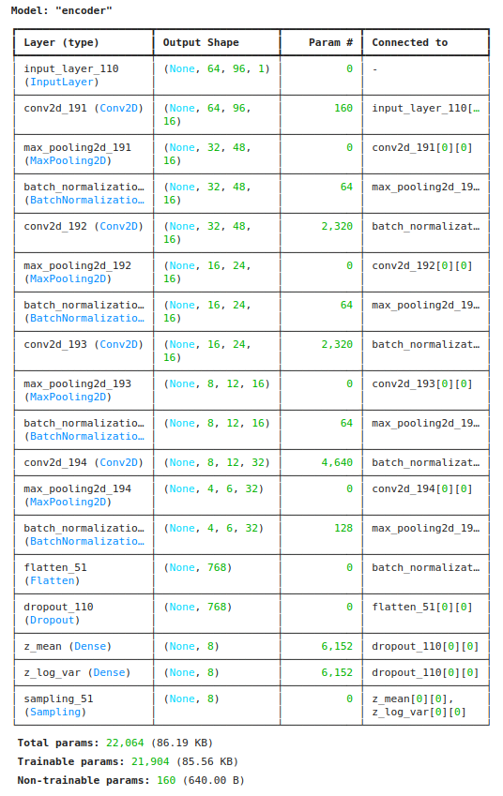
Notable models: the asymmetric (Encoder)
Beta parameter = 1e-1

Slide 24
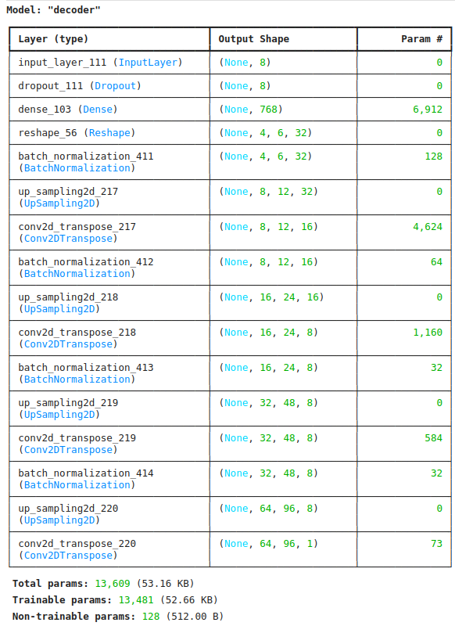
Notable models: the asymmetric (Decoder)
Beta parameter = 1e-1

Slide 25
Notable models: the asymmetric
Original_asym3
Test_orig_asym
Recon_asym3
Test_recon_asym
Recon_lat_noised_asym3
Test_orig_asym2
Mean_yes_asym3
Test_recon_asym2

Slide 26
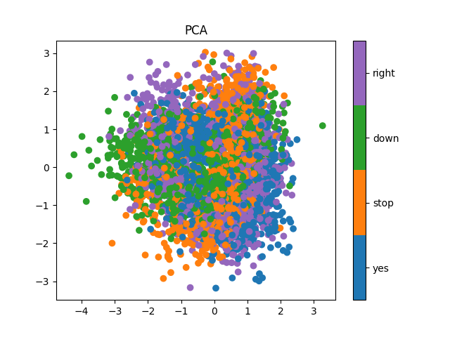
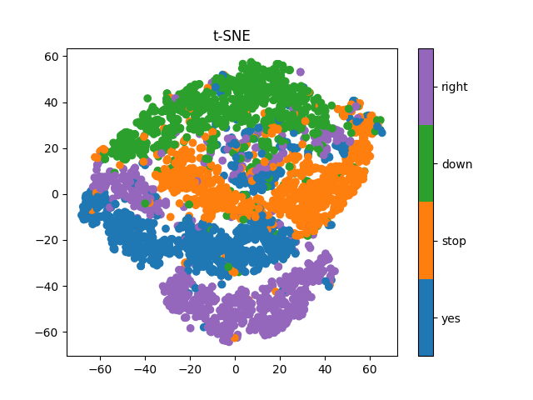
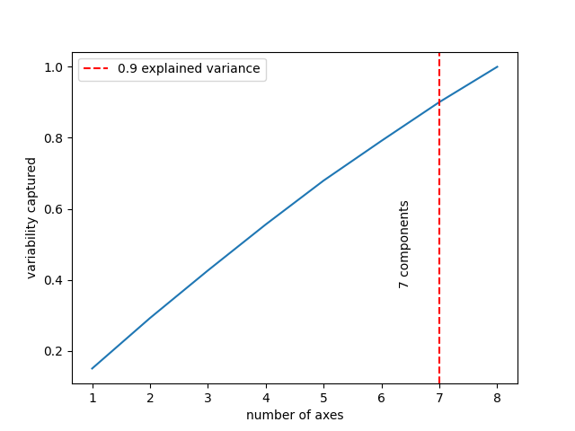
Notable models: the asymmetric
Fewer labels -> more defined clusters
Smaller latent dimension -> less fuzzy 2d PCA
Explained variance suggesting higher ldim

Slide 27
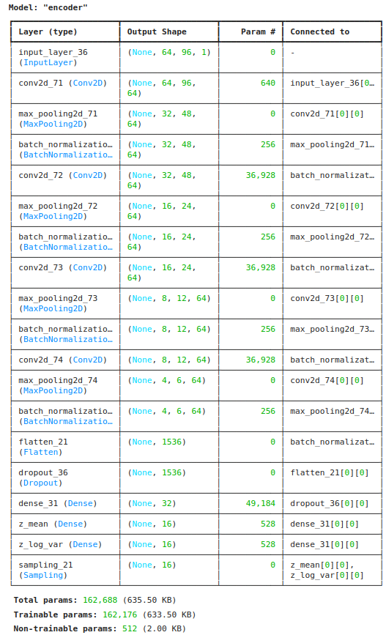
Notable models: midpoint
Original_mp1
noised_mp1
Recon_noised_mp1
Mean_stop_mp
Original_mp2
Regenerated_mp2
Latent_noised_mp2

Slide 28
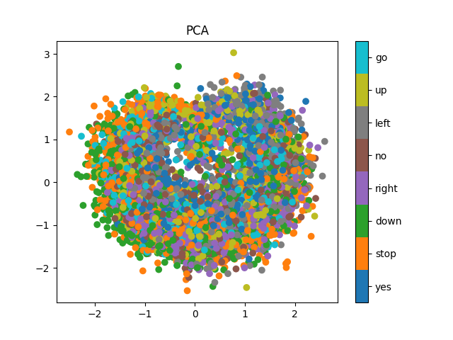
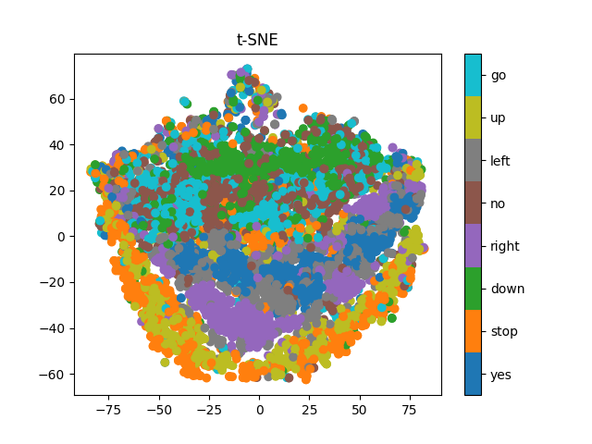
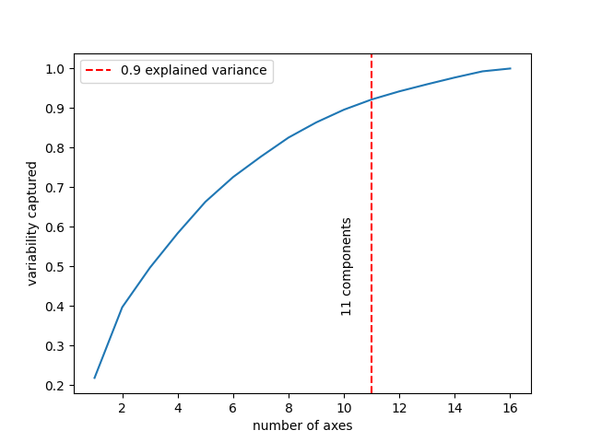
Notable models: the midpoint
Beta parameter = 1e-2

Slide 29
Notes on beta parameter
The beta parameter was typically chosen between 1e-3 and 1e-1
higher values did not allow the model to replicate the input data
Large values of beta do not allow the model to utilize the whole latent space
Lower values would result in no control over the latent space
While it can be a useful tool to prevent overfitting, large training data is needed for more freedom of use

Slide 30
Gaussian mixture model clustering
Initiate means and variances like the K-Means neighbours algorithm.
Calculate probability of each data point belonging to a each cluster.
Update the parameters according to how much the c-th distribution is responsible for the generation the i-th data point.(responsibility)
A grid search over different values of step and minimum size for DBSCAN did not provide clusters in a high dimensional data while it worked in some of the t_SNE maps.

Slide 31
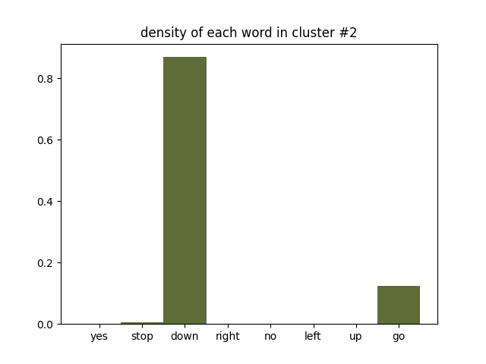
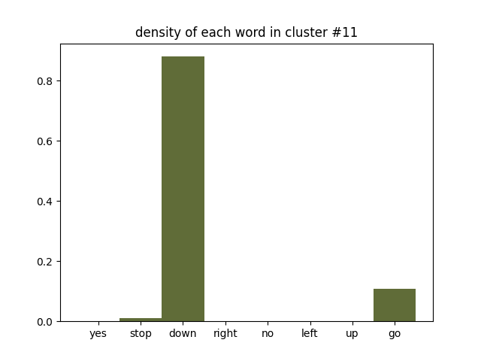
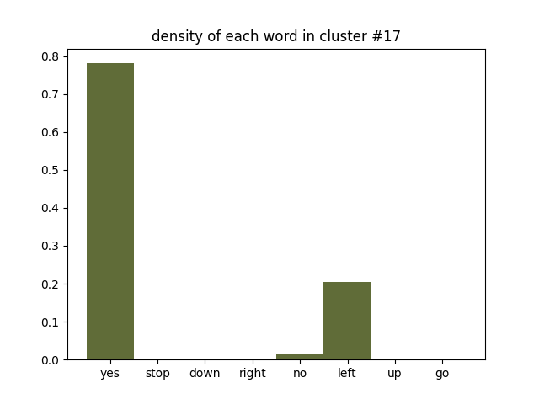
Homogeneous clusters

Slide 32
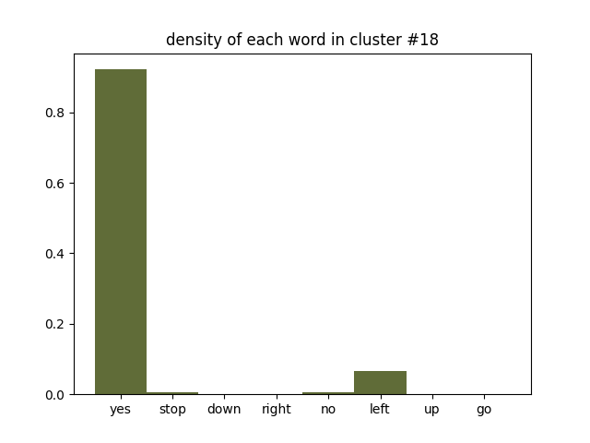
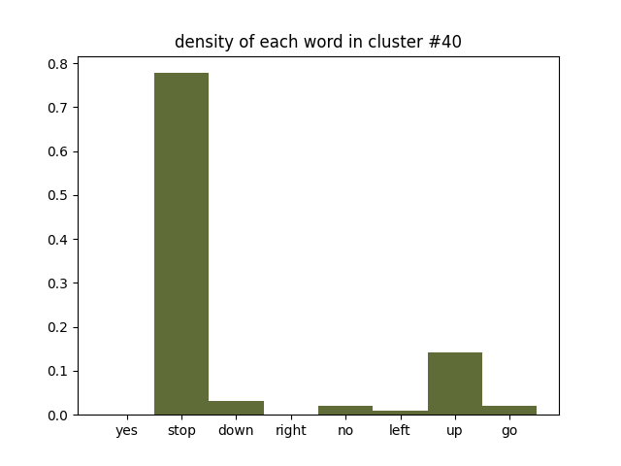
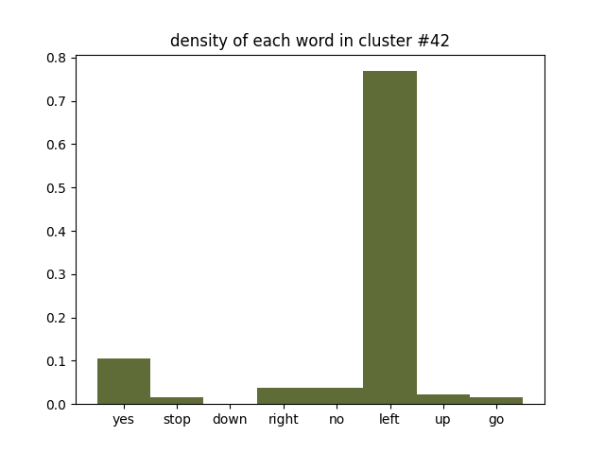
Homogeneous clusters

Slide 33
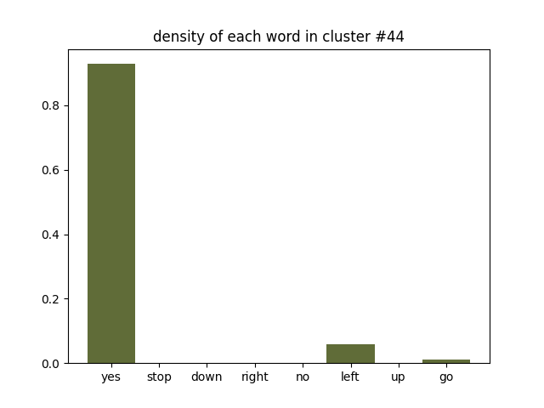
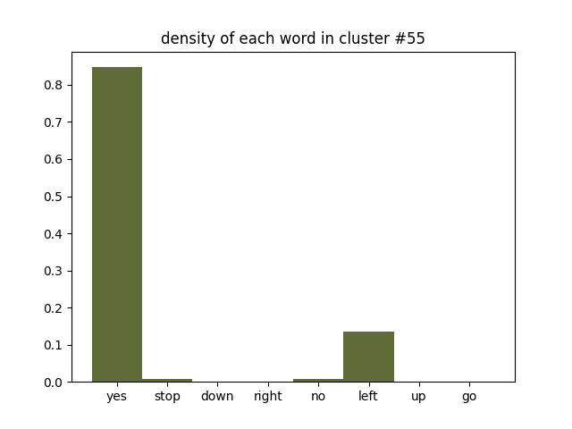
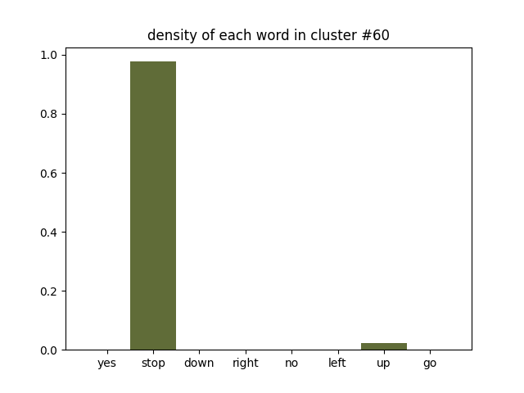
Homogeneous clusters

Slide 34
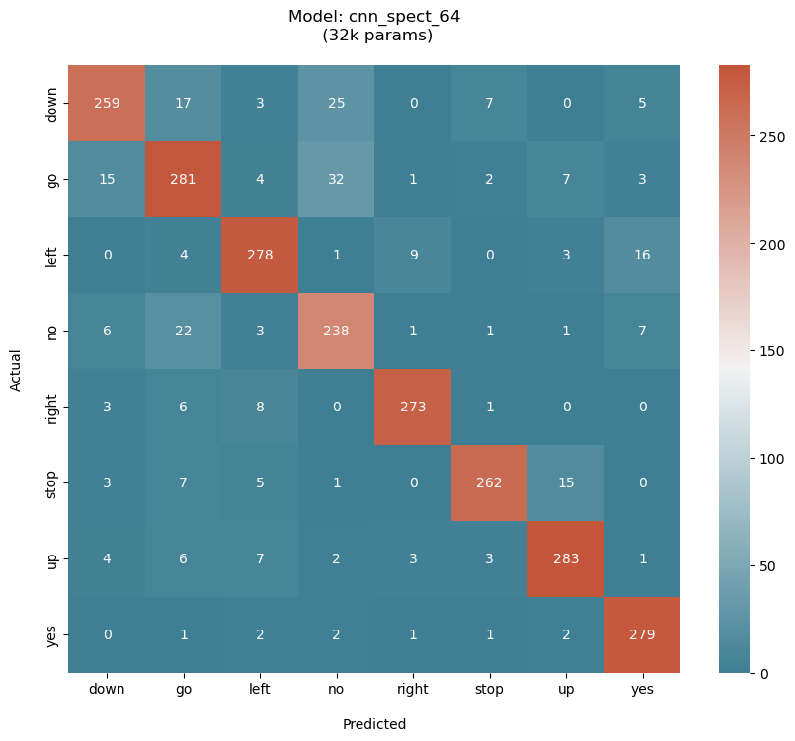
Confusion Matrix

Slide 35
THANK YOU

